Slide 1
OPEN IIT
DATA ANALYTICS
TEAM 44

Slide 2
TABLE OF CONTENTS
Here’s what you’ll find in this presentation:
Introduction and Overview
Data Description
Model Specification
Model Fitting
Implementation
Conclusion

Slide 3
INTRODUCTION
Music has greatly been evolving over the years, with new trends coming in and increasing demands of the audience.
With a huge competition between music labels to purchase the best music tracks, it’s really important that investments are made in the correct places.

Slide 4
OVERVIEW
Very High
High
The following data analysis has been done for a music record label to help them purchase the most appropriate music track.
A set of features describing the music tracks have been provided in correspondence to the popularity of the music track.
Based on the predictions, 10000(in 10k $) will be invested to place bids on the 4000 music tracks. This model is expected to generate the highest possible revenue.
Average
Low
Very Low
CLASSIFICATION OF POPULARITIES

Slide 5
01
DATA DESCRIPTION
Understanding the dataset better and drawing inferences from it.

Slide 6
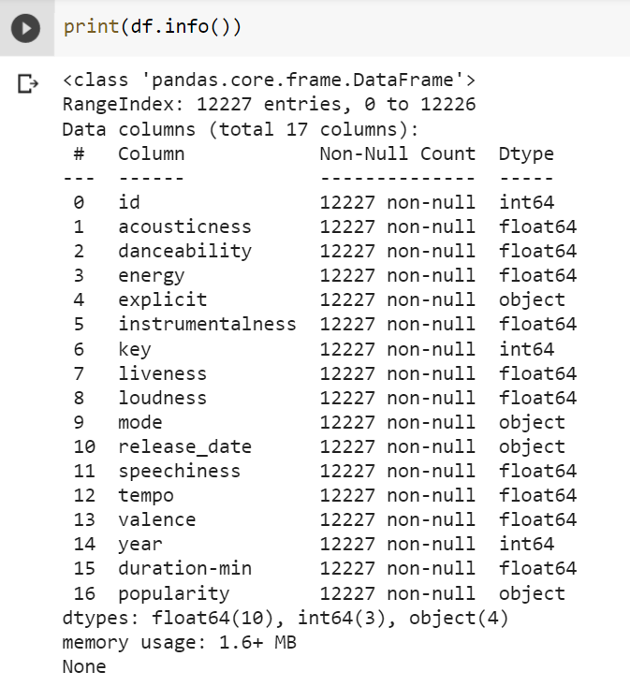
Train Dataset:
12,227 rows (datapoints)
16 features
13 continuous features
3 categorical features

Slide 7
02
DATA VISUALISATION
Observing and drawing conclusions from the dataset

Slide 8
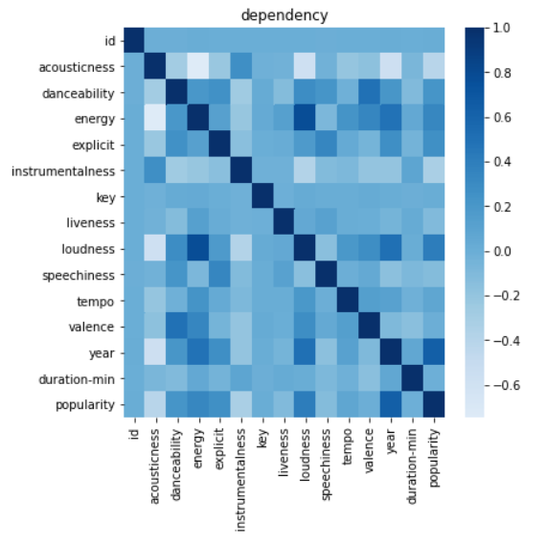
HEAT MAP FOR CORRELATION MATRIX
Observations:
Our target variable (popularity) has a highest positive dependency with “year”.
It has the highest negative dependency with “Acousticness” having a correlation coefficient of -0.407.

Slide 9
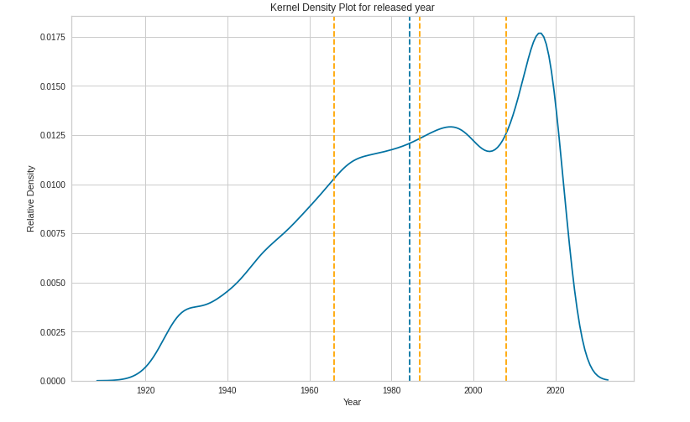
Distribution over the years
Observations:
We observed that more number of music tracks are being released with time.
Also to incorporate the effect of release year, we create 10 bins representing the deciles of release years.

Slide 10
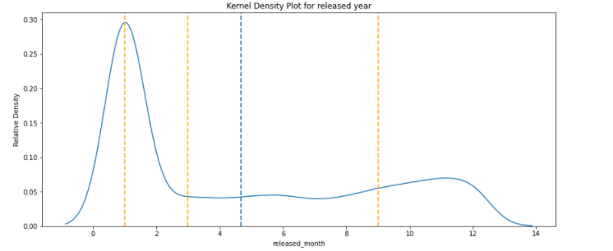
Distribution over a month
Observations:
Most of the songs are released either during the start or the end of a year.
We incorporate the effect of the month release by using it as a categorical variable (to check for any festive or vacation or seasonal effect)

Slide 11
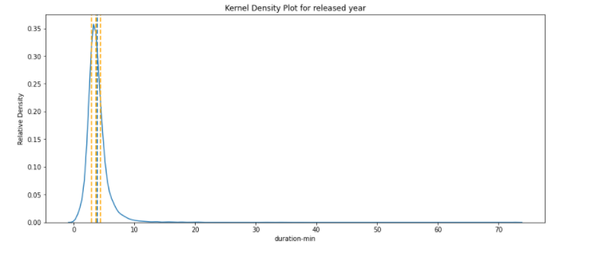
Distribution over the duration
Observations:
We prefer to think that song tracks of certain duration are more popular than others.
To incorporate that in our more we create 10 bins for the “duration” after finding its deciles.

Slide 12
03
MODEL SPECIFICATION
Using our conclusions to draw out useful variables
and dataset splitting

Slide 13
CREATION OF NEW VARIABLES
Year Buckets:
From the kernel density plot, it can be concluded that the frequency of songs has been rising in the recent two decades. To uniformly study the distribution and draw appropriate logical conclusions, we split the data into 10 cohorts.
Month:
With music being dependent a lot on festive seasons and occasions around, the month of launch might also act as a parameter to decide how popular a song is. So from the ‘date’ feature we go on to create a new variable ‘month’.
Duration Buckets:
Similarly we found a lot of uneven distribution in the duration of songs, with it getting denser in the 5-7 minute region. Hence, to uniformly distribute we split the duration into 10 equal cohorts.

Slide 14
DUMMY VARIABLES
All the categorical variables in the dataset are converted to dummy variables.
New feature for each category created and values are replaced with dummy variables.
Where, 1 represents the presence of that feature and 0 the absence of that feature.
Released_month Duration_bucket Year_bucket Key Explicit Mode
Dummy Variables for the above mentioned features have been created

Slide 15
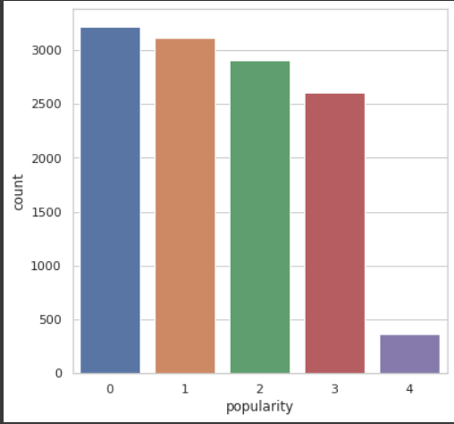
Histogram
Tabular
CHECK FOR BALANCED CLASSES
Representation
Popularity | Numerical Representation | Test data Count
Very Low | 0 | 3222
Low | 1 | 3118
Average | 2 | 2912
High | 3 | 2606
Very High | 4 | 369
Note: Classes are unbalanced, especially “Very Popularity” class with only 369 values.

Slide 16
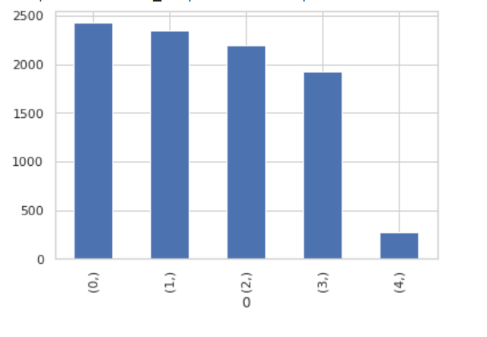
TRAIN-VALIDATION SPLIT
Histogram
Tabular
Data
Ratio: (75:25)
Popularity ( Numerical Representation) | Test data Count of Training Set
0 | 2428
1 | 2348
2 | 2128
3 | 1928
4 | 277
Training Set
Validation Set
In training the data count for the songs in the “very high” category is low, the model needs sufficient data to learn parameters so that it can correctly classify the “very high” category

Slide 17
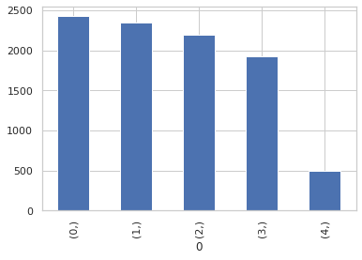
BALANCING THE IMBALANCE
Histogram
Tabular
Popularity ( Numerical Representation) | Test data Count of Training Set
0 | 2428
1 | 2348
2 | 2128
3 | 1928
4 | 500
Oversampling
Adjusted the class distribution of a data set (i.e. the ratio between the different classes)
Increased the training data count by random sampling.
We don’t do oversampling for the validation set to maintain consistency of the model.
We wish to create a model which can be used again and again on different real datasets.

Slide 18
04
MODEL FITTING
Testing different
classification models and choosing one

Slide 19
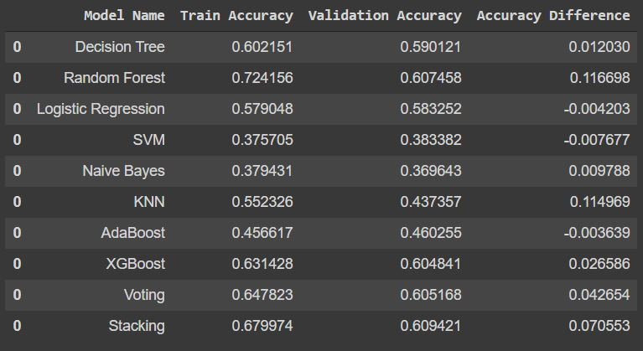
SUMMARY OF MODELS USED

Slide 20
CHOOSING THE BEST MODEL
Best model should have:
High Validation accuracy
Low difference in Test and Validation accuracy
The confusion matrix with wrongly predicted values concentrated near the diagonal and most importantly in lower/left side of the matrix

Slide 21
THE MODEL WE CHOSE
Random Forest
72%
60%
Hyper-parameters
N_estimators: 50 max_depth: 17 min_samples_leaf: 7
Train Accuracy Validation Accuracy

Slide 22
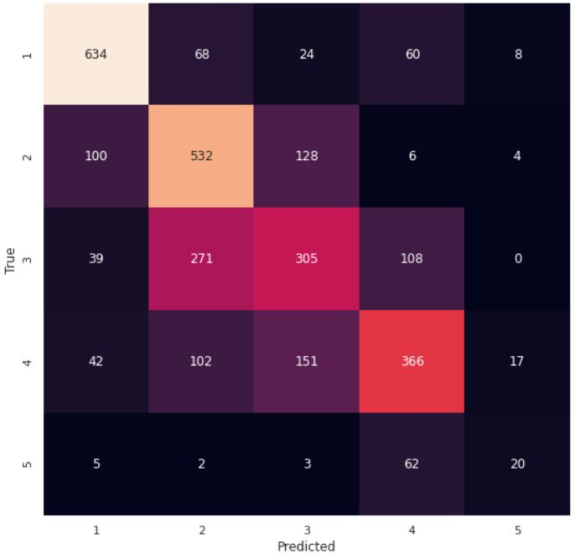
CONFUSION MATRIX

Slide 23
05
IMPLEMENTATION
Using the developed model to make predictions

Slide 24
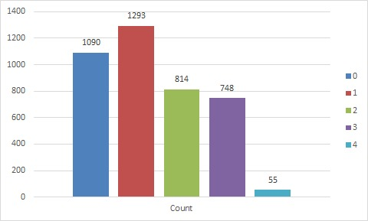
DISTRIBUTION OF PREDICTION SET

Slide 25
06
CONCLUSION
Final points

Slide 26
We have created a model using Random Forest architecture and some hyper-parameters to tune it to predict a song track’s popularity with a accuracy of 72%. This is done in order to make bets and earn maximum revenue.
Our algorithm reduces chances of making wrong prediction.
In implementation again we find a very low set of “very high” popularity song tracks.
The created model can be updated using neural networks and more training data, for higher accuracy.

Slide 27
THANKS

